Slide 1

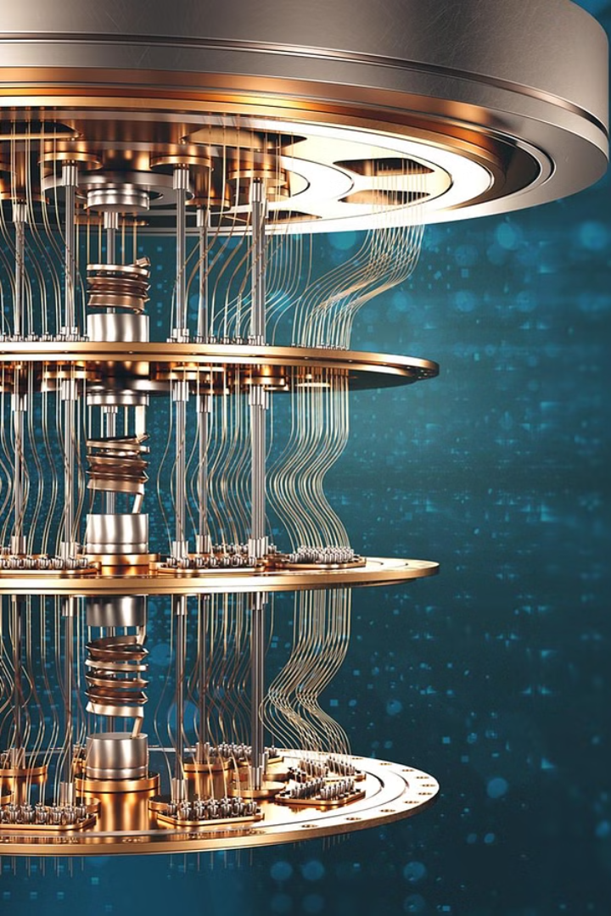


Quantum Computing: The Future of Technology
Quantum computing represents the next frontier in technology, harnessing the unique properties of quantum mechanics to revolutionize data processing and problem-solving. This cutting-edge field promises to unlock unprecedented computational power, ushering in a new era of scientific breakthroughs and technological advancements.
by Natnael Sisay

Slide 2
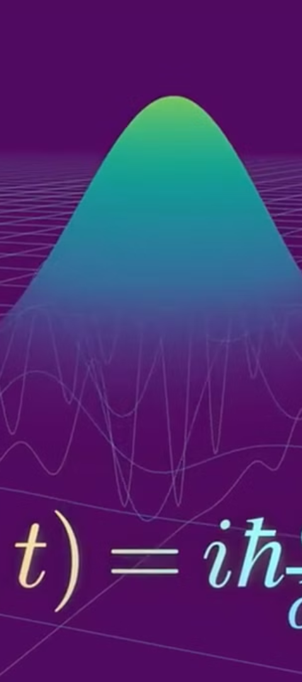
Introduction to Quantum Mechanics
1
Superposition
2
Entanglement
Quantum particles can exist in multiple states simultaneously, a phenomenon known as superposition, which forms the foundation of quantum computing.
Quantum particles can become "entangled," where the state of one particle is inextricably linked to the state of another, even over vast distances.
3
Probabilistic Behavior
Quantum systems exhibit probabilistic behavior, where the outcome of a measurement or observation is not deterministic but rather a distribution of possible states.

Slide 3
Principles of Quantum Computing
Qubits
Quantum Algorithms
Quantum Gates
The basic unit of information in quantum computing is the qubit, which can represent a 0, a 1, or a superposition of both states simultaneously.
Quantum algorithms leverage the unique properties of quantum mechanics to perform certain computations exponentially faster than classical computers.
Quantum gates are the building blocks of quantum circuits, allowing for the manipulation and transformation of qubits to perform specific computational tasks.

Slide 4

Advantages of Quantum Computing
Speed
1
Quantum computers can solve certain problems, such as factoring large numbers and searching unstructured databases, exponentially faster than classical computers.
2
Efficiency
Quantum computers can operate with a fraction of the energy and resources required by traditional computers, making them more energy-efficient and environmentally friendly.
Cryptography
3
Quantum computers will be able to break many of the encryption methods used today, but they also present opportunities for the development of unbreakable quantum-secure cryptography.

Slide 5
Current Applications of Quantum Computing
Financial Modeling
Quantum Chemistry
Machine Learning
Quantum computers can simulate complex financial models and optimize investment portfolios, leading to more accurate predictions and improved decision-making in the financial sector.
Quantum computers can simulate the behavior of complex molecules and chemical reactions, accelerating drug discovery and the development of new materials.
Quantum algorithms can enhance machine learning models by providing faster data processing, improved pattern recognition, and more efficient training of neural networks.

Slide 6
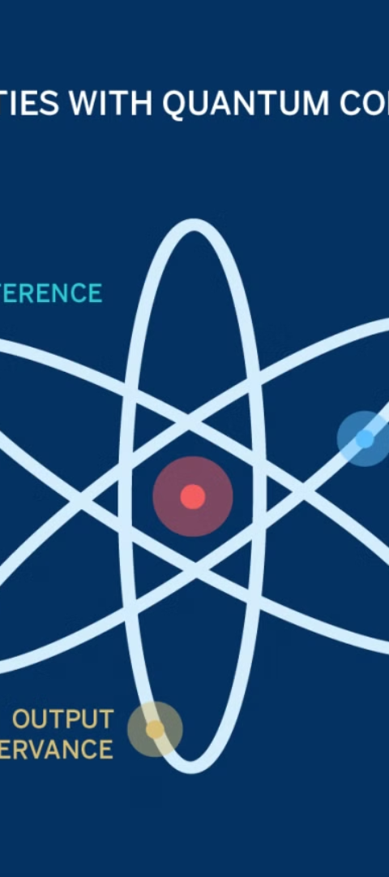
Challenges and Limitations
1
Fragile Qubits
2
Error Correction
Qubits are extremely delicate and susceptible to environmental noise and interference, making them challenging to maintain in a stable state for extended periods.
Developing effective error correction and fault-tolerance techniques is crucial to ensure the reliability and accuracy of quantum computations.
3
Scalability
Scaling up quantum computers to handle larger and more complex problems is a significant engineering challenge that researchers are actively working to overcome.

Slide 7
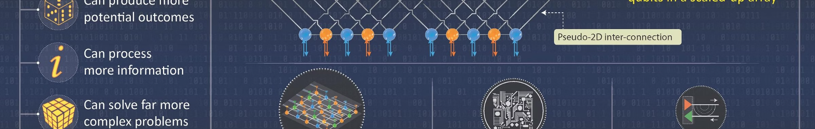



The Future of Quantum Computing
Commercialization
Quantum Internet
Quantum Supremacy
As the technology matures, quantum computers are expected to become more accessible and affordable, leading to their widespread adoption across various industries.
The development of a quantum internet, which can transmit information using quantum mechanics, will enable secure communication and distributed quantum computing.
Achieving "quantum supremacy," where quantum computers outperform classical computers on specific tasks, will be a significant milestone in the field, paving the way for even more advanced applications.

Slide 8

Conclusion: Embracing the Quantum Revolution
Quantum computing represents a transformative shift in the world of technology, promising to unlock unprecedented computational power and unlock solutions to some of the most complex challenges facing humanity. By embracing this quantum revolution, we can expect to witness groundbreaking advancements in fields ranging from science and medicine to finance and cybersecurity, shaping the future of our world.

Slide 9
Will be added finally

Slide 10

asdfasdfasdfafasdfadf
asdfa
asdfaf
asdf

